Slide 1




ELICIT-PLUS – 2014-1-FR01-KA200-002362
This project has been funded with support from the European Commission. This communication reflects the views only of the author and the Commission cannot be held responsible for any use which can be made of the information contained therein.

Slide 2
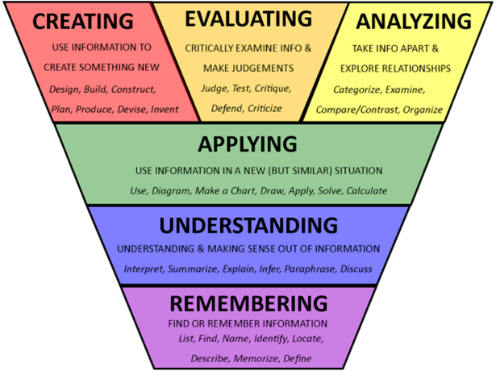
Taxonomies
Benjamin Bloom – Cognitive domain

Slide 3
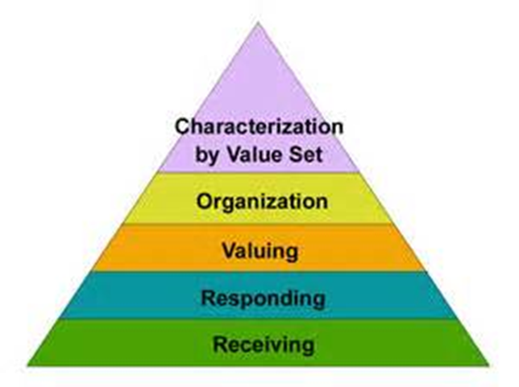
Taxonomies
Affective domain - Lorin Anderson, David Krathwohl
To act consistently in accordance with the values he or she has internalized.
To relate the value to those already held and bring it into a harmonious and internally consistent philosophy.
Willing to be perceived by others as valuing certain ideas, materials or phenomena.
Committed in some small measure to the ideas materials,
or phenomena involved by actively responding to them.
Being aware of or sensitive to the existence of certain ideas
or phenomena and being willing to tolerate them.

Slide 4
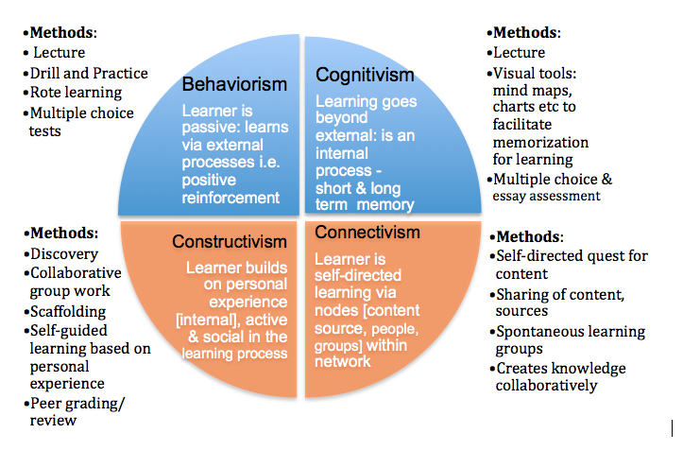
Theories of knowledge

Slide 5

Selected training suggestions
Lucreţia ŞIRINIAN
Vasile NICOARĂ

Slide 6

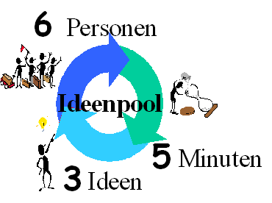
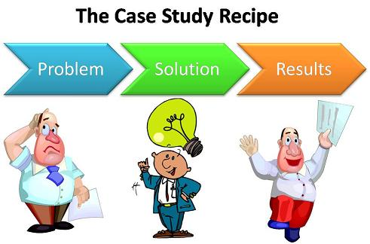

Co-operative teaching-learning strategies
Brainwriting
Buzz groups

Slide 7






Fishbowl
Focus group

Slide 8




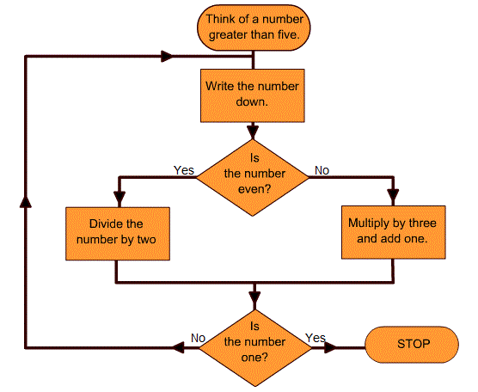

Flow chart

Slide 9


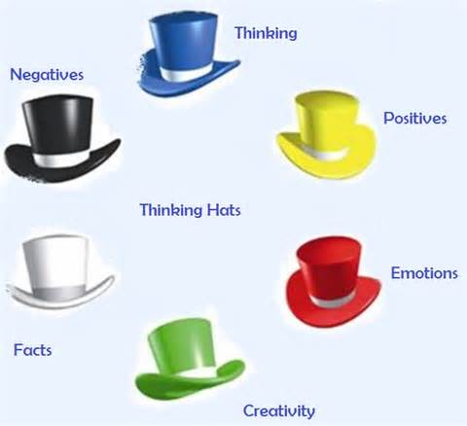
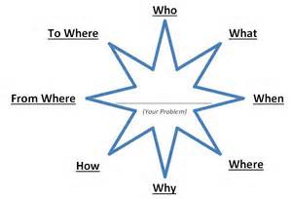
Philips 6/6
Thinking hats
Starbursting

Slide 10
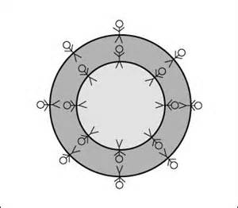
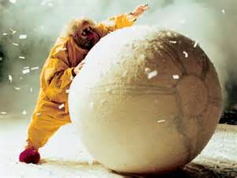


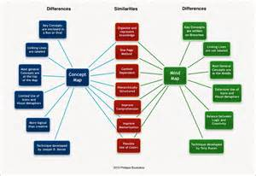
Share-pair circles
Snowball
Cube
Conceptual map
Grape

Slide 11

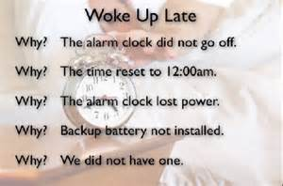
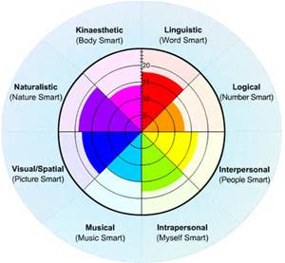
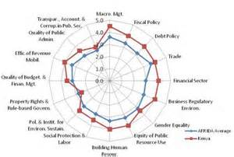
Cognitive chains
The 5 Why
Camembert
Spiderweb

Slide 12
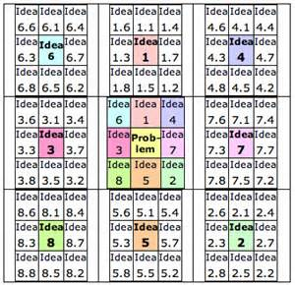
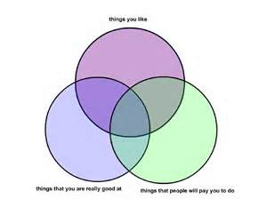

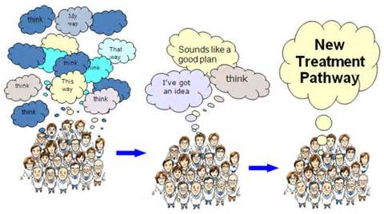
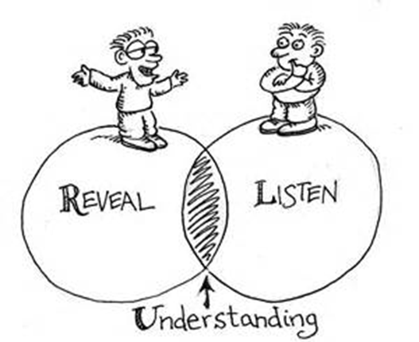
Lotus blossom
Venn
Delphi

Slide 13
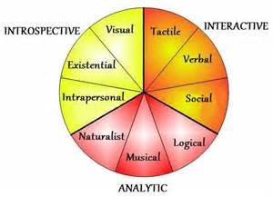
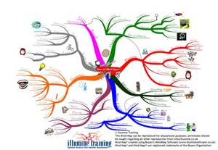
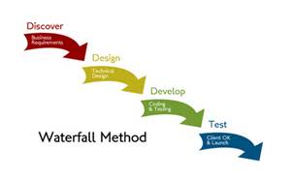
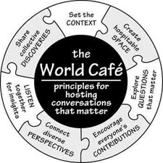
Multiple intelligences
Mind map

Slide 14

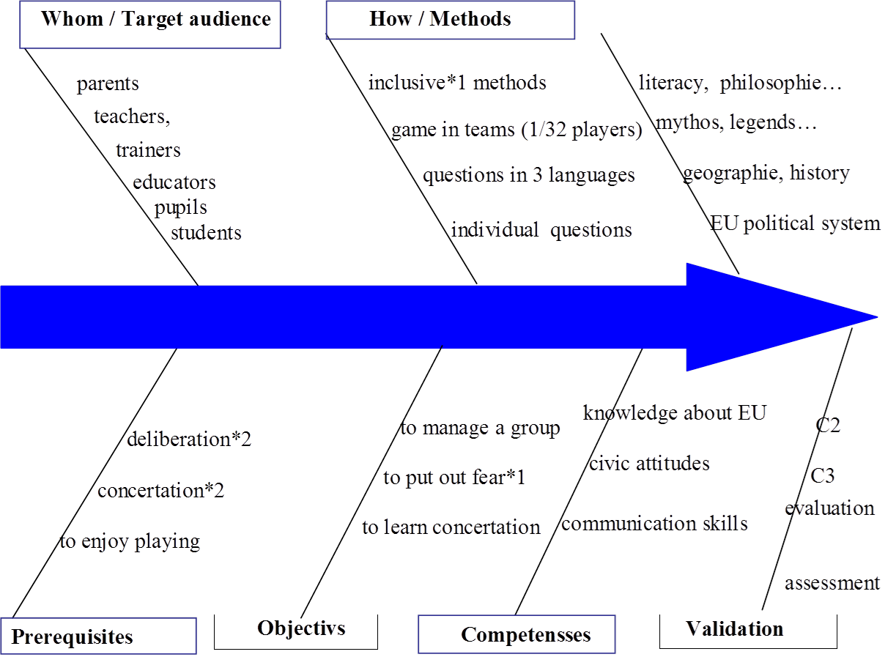
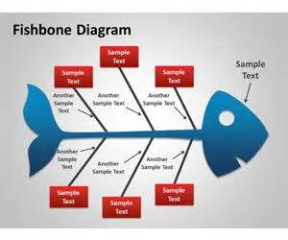
Fishbone – Exemple - Game Euro culture – Chantal Laroche

Slide 15
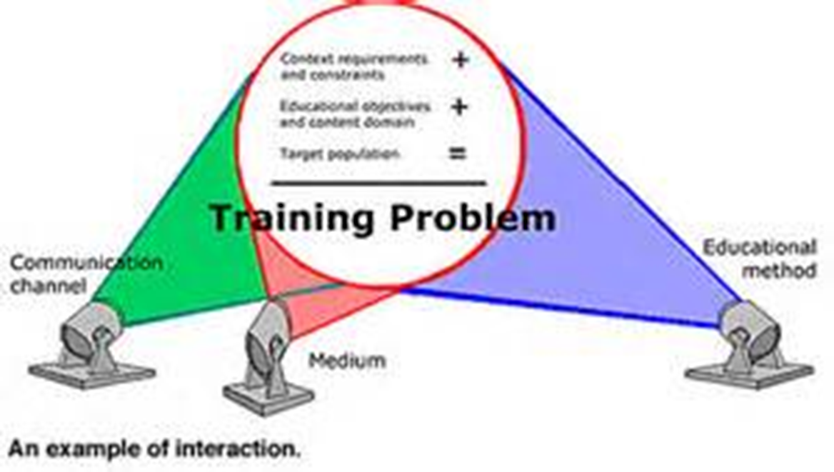

Slide 16


Lucreţia Şirinian & Vasile Nicoară
Fundaţia Academică „Alumni”, Constanţa – Romania

