Slide 1
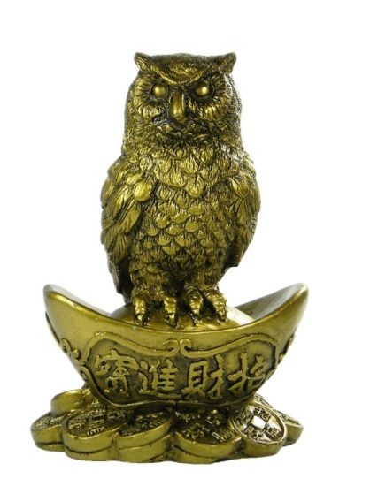

Popular wisdom through proverbs and sayings
Vasile Nicoară & Lucreţia Şirinian
25 Alumni – Constanţa – România

Slide 2



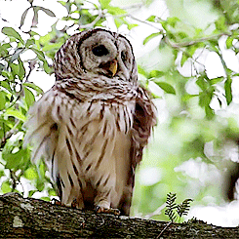







* Wisdom is a marchandise: he who sells it buyed it.
* La sagesse est une marchandise: qui la vend l’a achetée.
* La saggezza è una merce: chi vende l’ha acquistato.
* Die Weisheit ist eine Waare: wer es verkauft hat es gekauft.
* A bölcsesség egy olyan árucikk, hogy eladja l vásárolt.
* De wijsheid is een basisproduct dat verkoopt l heeft gekocht.
* Мъдростта е стока, че продава l е закупен.
* Înţelepciunea este o marfă: cine o vinde a cumpărat-o.
Nicolae Iorga – Romanian philosopher

Slide 3
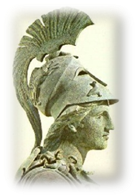
Our common latinity
* Ad augusta per angusta. * Ad litteram. * Alea jacta est. * Alter ego. * Audaces fortuna juvat. * Aurea mediocritas. * Aut Caesar, aut nihil! * Ave Caesar, morituri te salutant! * Bis dat qui cito dat. * Carpe diem! * Castigat ridendo mores. * De gustibus et coloribus non disputandum. * Deus ex machina. * Divide et impera. * Dura lex sed lex. * Eureka! * Ejusdem farinae. * Eppur si muove! * Est modus in rebus. * Fiat lux! * Ex nihilo nihil. * Festina lente! * Fluctuat nec mergitur. * Ipso facto. * In dubio pro rem. * In vino veritas.

Slide 4
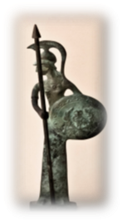
Identical sayings
  * To be quiet as a mouse. * To throw pearls to pigs.
  * To add fuel to the flames. * To be back to the wall.
  * You can't make omelette without breaking eggs.
  * You can't see the wood for the trees. * To see red.
  * In one ear and out the other. * To move heaven and earth.
  * To have a foot in the grave. * One hand washes the other.
  * To act in the twinkling of an eye. * To open old wounds.
  * Money doesn't grow on trees. * There is no smoke without fire.

Slide 5
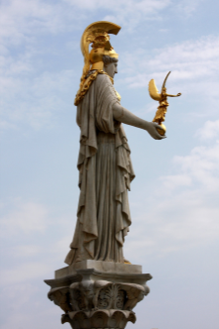
Identical sayings
* To take the bull by the horns. * To take your courage in both hands. * To throw dust in someone's eyes. * To refuse the sour grapes. * Neither fish nor fowl. * It is a storm in a teacup. * To get on your high horse. * A hot potato. * The scales fall from your eyes. * To get on one's nerves. * To sleep like a log. * To bite your tongue. * The game is not worth the candle. * To walk on eggshells. * A 9/3-days wonder. * To be rolling/bathing in money. * To swallow his own words. * To have two left feet/hands. * To be the fifth wheel of the coach.

Slide 6


A păstra bani albi pentru zile negre.
Garder de l’argent blanc pour les journées noires.
To keep white money for black days.
Garder une poire pour la soif.
To keep something for the raining day.
Very similar sayings
A cădea din lac în puţ.
Tomber du lac dans le puits.
To fall from the lake into a hole.
Aller de mal en pis.
To go from bad to worse.

Slide 7

Cui pe cui scoate.
Un clou pousse l’autre.
A nail pushes the other.
A menteur menteur et demi.
It takes a thief to catch a thief.
Very similar sayings
Sacul și peticul.
C’est le sac et son lambeau.
It is the bag and its patch.
A chacun sa chacune.
Every Jack has his Jill.

Slide 8

Dumnezeu îţi dă, dar nu-ţi bagă în traistă.
Dieu te donne, mais il ne te met pas dans la besace.
God gives you, but he does not put it into your bag.
On peut mener un cheval à l’abreuvoir, mais non le forcer à boire.
You can lead a horse to the water, but you cant make him drink.
Very similar sayings
Corb la corb nu scoate ochii.
Un corbeau n’arrache pas les yeux de l’autre.
Crow does not pick crows eyes.
Le chien ne mange pas le chien.
Dog does not eat dog.

Slide 9
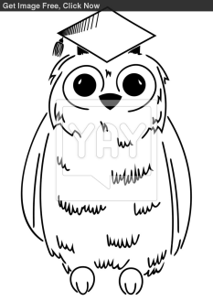
Copilul cu multe moaşe, rămâne cu buricul netăiat.
L’enfant avec trop de sage-femmes a le nombril non coupé.
The child with to many wise women has the navel uncut.
Trop de cuisiniers gâtent la sauce.
Too many cooks spoil the broth.
Very similar sayings
Cine s-a fript cu supă suflă şi în iaurt.
Qui s’est brulé avec la soupe souffle même dans le yaourt.
He who was burned with soup puffs even in yoghourt.
Chat echaudé craint l’eau froide.
The burned cat fears even cold water.

Slide 10

Ce e în mână nu-i minciună.
Ce que l’on a dans la main n’est pas mensonge.
What you have in your hand is not a lie.
Un oiseau dans la main vaut deux dans la brousse.
A bird in the hand is worth two in the bush.
Very similar sayings
A fost prins cu mâţa în sac.
Il a été pris le chat dans le sac.
He was caught the cat in the bag.
Pris la main dans le sac.
Caught with the fang.

Slide 11

Etre preoccupé / To be preoccupied
Il n’a pas tous ses boeufs à la maison.
He has not all his oxes at home.
Mentir / Lying
Mentir à faire geler les eaux.
To lye to freeze waters.
Romanian sayings
Gaspiller du temps / Waisting time
Couper des feuilles pour les chiens.
To cut leaves for the dogs.
Parler trop / Speeking to much.
Babiller comme un moulin détérioré.
To talk like a broken mill.

Slide 12
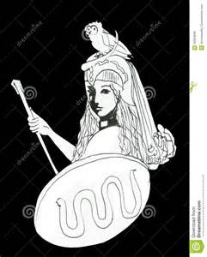
Séparation sans regrets / Separation without regrets
Salut et un poireau vert!
Bye and a green leek!
Se sentir coupable / To feel guilty
Il sent la mouche sur son chapeau.
He feels the fly on his hat.
Romanian sayings
Amour vrai / True love
Il l’aime comme le sel dans le plat.
He loves him like the salt in the dishes.
Avoir tout le pouvoir / To have all the power
Il a le pain et le couteau.
He has the knife and the bread.

Slide 13

Romanian sayings
Etre confus / To be confuse
Marcher comme une dinde ivre.
To walk like a drunk turkey.
Etre pauvre / To be poor
Il tire le chat par la queue.
He is pulling the cat by its tail.
Etre chanceux / To be lucky
À cygogne borgne Dieu fait le nid.
For the one-eyed stork God builts the nest.
Etre impulsionné / To be pushed
Etre fourré dans une prise.
To be sticked in a plugg.

Slide 14

Romanian sayings
Profiteur / Profiteer
Il tête deux brebis.
He is sucking two sheeps.
Faire des allusions / To make references
Frapper la selle pour que la jument comprenne.
To hit the sadle for that the mare understands.
Etre ennuyant / To be boring
Faire la théorie de l’allumette.
To expose the theory of the matchstick.
Manque de pitie / Lake of mercy
Il n’a ni mère ni père.
He has no mother nor father.

Slide 15

Romanian sayings
Etre bête / To be stupid
Il a une cervelle de poule.
He has a chickens mind.
Parler sans logique / To talk without logic
Il parle de vertes et de sèches.
He is talking about green and dry leaves.
Etre ignorant / To be ignorant
Il reste comme un veau devant un portail neuf.
He is staying like a veal in front of a new portal.
Compromis / Compromise
Il a concilié la chèvre avec le chou.
He conciliated the goat with the cabbage.

Slide 16
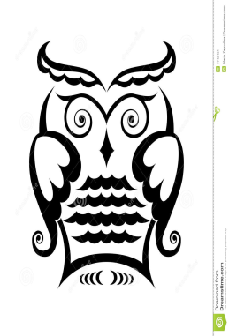
Agir inutilement / To act useless
Il cherche des chevaux verts sur les murs.
He is seeking green horses on the walls.
Fier sans raison / Proud without reason
Se balader comme une poule une paille au cul.
To walk like a chicken with a straw in its ass.
Romanian sayings
Faute fatale / Fatal mistake
Il a coupé la branche sous ses pieds.
He cut the branch under his feets.
Mauvaise prononciation / Bad pronounciation
Il a des prunes dans sa bouche.
He has plums in his mouth.

Slide 17
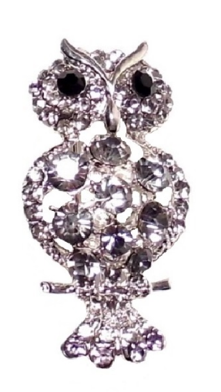
Original French sayings
Cela lui va comme un faux col à une vache.
It fits him like a false collar to a cow.
Il a un nom à coucher dehors.
He has a name to sleep outside.
Cela coupe comme un genou.
It cuts like a knee.
Mentir comme un soutien gorge.
To lie like a brassiere.
Aller comme des guêtres à un lapin.
Fit like gaiters to a rabbit.

Slide 18

International proverbs …
in a French humoristical interpretation
Tout ce qui brille n’est pas … Dior.
All that glitters is not … Dior.
Bière qui coule … ramasse la mousse.
Beer (piere) that flows … pics up the foam.
Qui vole un boeuf … est vachement musclé.
He who steels an ox …. has strong muscles.
Qui met la charrue avant les boeufs …. fait rire le tracteur.
He who puts the cart before horses …. makes laugh the tractor.

Slide 19
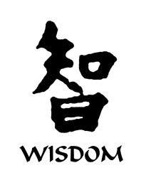
International proverbs …
in an English humoristical interpretation
A bird in the hand is safer than one overhead.
Un oiseau dans la main est plus sûr qu’un oiseau sur la main.
You can lead a fool to wisdom, bur you cant make him think.
On peut mener un fou à la sagesse, mais on ne peut pas le faire penser.
If it is true that we are here to help others, than, what exactly are the
others here for?
Si c’est vrai que nous sommes ici pour aider les autres, pourquoi exactement y sont les autres?

Slide 20
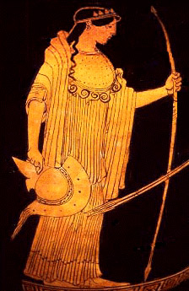
International proverbs …
in an English humoristical interpretation
A conscience does not prevent sin. It only prevents you from enjoing it.
Une conscience n’empèche pas un péché. Elle vous empèche seulement d’en jouir.
A ship in a harbor is safe … but that is not what ships are built for.
Un bateau au port est en sureté … mais ce n'est pas pour cela que
les bateaux sont construits.
Where is a fire, there comes the fireman insurance company.
Où il y a un feu, il y a aussi une compagnie d’assurance des pompiers.
War does not determine who is right; it only determins who is left.

Slide 21
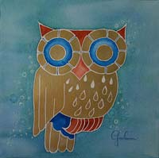
International proverbs …
in a Romanian humoristical interpretation
Qui vole aujourd’hui un oeuf ….. est un boeuf!
He that steals today an egg … is an ox.
Fish rots from the head … but it is cleaned from the tail.
Le poisson pourrit par la tête … mais il est écaillé par la queue.
Silence is golden ….but nobody buys it from you.
Le silence est or …. mais personne ne vous l’achète.
He who laugh last… has not understood the joke.
Qui rira le dernier … n’aura pas compris le fin mot.

Slide 22
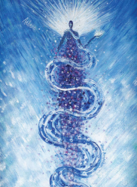
International proverbs …
in a Romanian humoristical interpretation
The early bird …. can go back to sleep/impedes the others to sleep.
Qui se lève tot …. peut se recoucher/empêche les autres de dormir.
Neighbors goat must too die … but let the neighbor die and let me take his goat.
Que meure aussi la chèvre du voisin … mais que le voisin meure pour que je prenne sa chèvre.
As you make your bed … so comes another and sleeps in it.
Comme on fait son lit … sitôt un autre vient s‘y coucher.

Slide 23
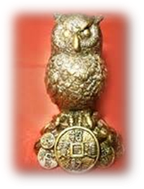
Original Romanian sayings
Ne parle pas de corde dans la maison du pendu.
Do not speak about a cord in the house of the hanged man.
Elle met ses jupes sur la tête. (femmes tziganes se querellant)
She puts hers skirts on her head. (Roma women arguing)
Ni ail mangé, ni haleine puante.
Neither garlic eaten nor stinking breath.
Il l’aime comme le sel aux yeux.
He loves her like salt in the eyes.
Les Turcs se battaient dans sa bouche. (gourmandise)
The Turcs were fighting at his mouth. (gluttony)

Slide 24
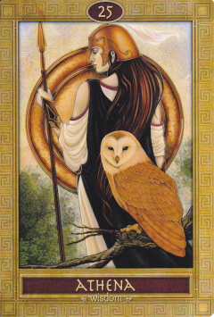
International proverbs
in an international humoristical interpretation
Le travail a créé l’homme … mais la paresse, non plus, n’a tué personne.
Work created the man … but leisure, neither, killed anybody.
L’amour fait beaucoup … mais l’argent fait tout.
Love makes much … but monney makes everything.
Il est bon d’espérer … mais aussi de posséder.
It is good to hope … but also to possess.

Slide 25
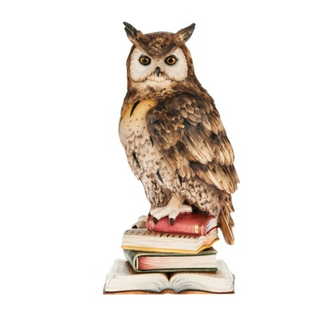
International proverbs
in an international humoristical interpretation
L’argent ne fait pas le bonheur … mais il y contribue.
Money does not make hapiness … but it contributes to.
Les hommes sages pensent pareil … mais les fous diffèrent rarement.
Wise men think alike … but fools seldom differ.
L’habit fait l’homme … mais ne jugez pas le livre d’après sa couverture.
The coat makes the man … but never judge a book by its cover.

Slide 26
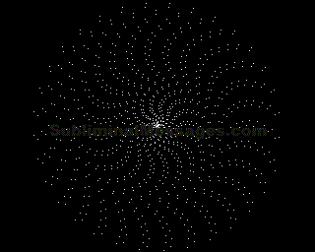
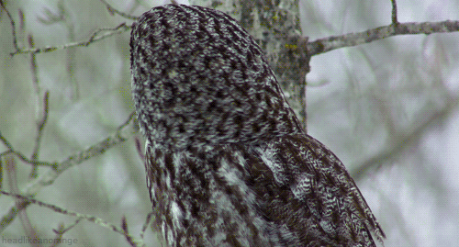
Thanks for your attention!
Remerciements pour votre attention!

