Slide 1
The Romanian Educational System
Past and Present

Slide 2
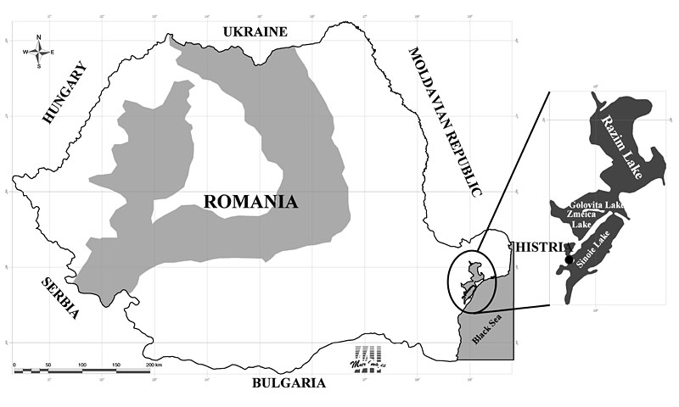
History
On the Dobrujan shore of the Black Sea there have been discovered proofs that certify the existence of the first school organized on the territory of the country which dates back to the 2nd century BC.

Slide 3
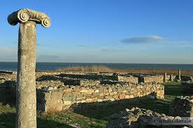
A local gymnasium was situated on the banks of the Sinoe lake whose existence is acknowledged by two epigraphic fragments and a few inscriptions that are still to be found at Histria and which describe the way it was organized.
It seems that the first level in educational training, that of acquiring the most basic forms of education such as writing, reading, basic mathematic skills and recitation of Homeric poems took place in the family, under the direct surveillance of the father or, in some cases, of a free man.

Slide 4
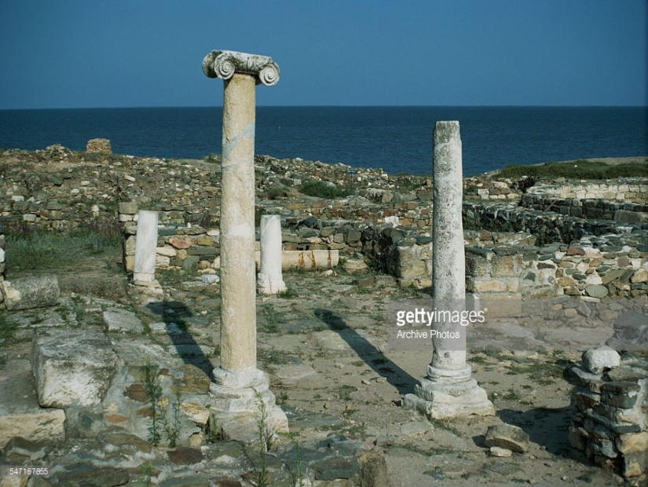
Those who could acquire knowledge in an organized environment and not in families attended the institution called “gymnasium” led by a headmaster called “gymnasiarch” who was helped by one or two teachers in his activity.
The organization and function of such an institution implied great responsibility and that is why the “gymnasiarch” was elected by the citizens from the well-off people.

Slide 5
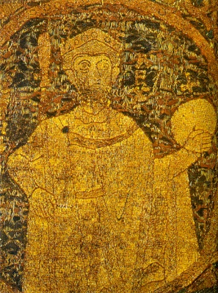
The first known school is presented in ‘Saint Gerard legend’ which has been common in Cenad (Banat) since 1028. It was established in order to prepare the clerics and missionaries and its capacity was of 30 students. In this school, in a building especially designed for this purpose, the young under the guidance of “magisters” studied writing, reading, elementary Latin grammar and church music.

Slide 6
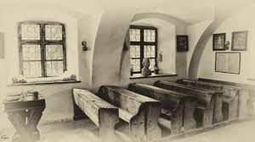
The classroom
The Romanian schools from villages and towns become more and more numerous in the 17thcentury. While in Transylvania there were confessional schools, in Moldavia and Wallachia there were public or state schools.
The historical conditions and the economic development of the time allowed the ruler Alexandru Ipsilanti, a man of vision, to reorganize the teaching system in 1776 according to broader pedagogical views.

Slide 7
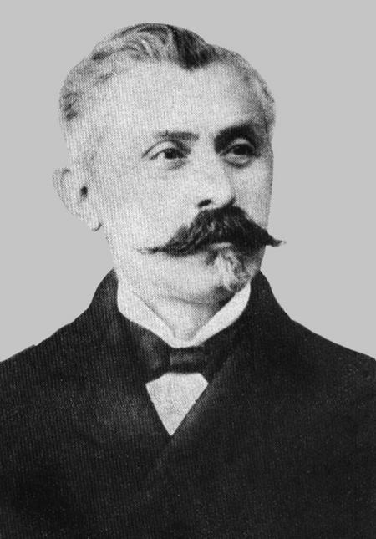
A flourishing period as far as the teaching system is concerned was during the mandate of Spiru Haret –ministry of education -who militated and also succeeded in developing the school system so that their number soared from 3446 schools in 1896 to 4685 in the school year 1909/1910.
During the interwar period there have been drown up numerous normative acts which led to the consolidation of Romanian teaching system both private and public. The first Romanian universities were founded in the second half of the 19th century (Iaşi- 1860, Bucureşti – 1864).

Slide 8
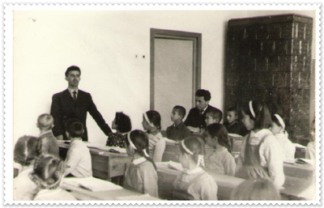
After World War II and the instauration of the communist regime, the liberal educational system has been replaced with one of soviet inspiration based on mass ideology and indoctrination.
During 1965-1975 the teaching system underwent a sort of ‘opening’ and it was reformed by a set of measures regarding the renouncement of the excessive ideologization, the recovery of some traditional customs, the study of foreign languages and exact sciences and also the connection to the Occidental developments, etc.

Slide 9
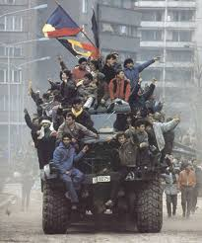
Even since the Romanian revolution in 1989 the Romanian teaching system has been in a continuous process of reorganization which was both praised and criticized.
According to the Law of National Education no 1/2011 the Romanian educational system is conducted by the Ministry of National Education, (MEN).
Each level has its own form of organization and it is subject to the current legislation.

Slide 10
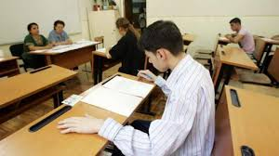
The system offers the following diplomas:: graduation diploma (graduation from school without exam), Baccalaureate diploma (graduation from high school after the final exam), bachelor degree (graduation from university after an exam and/or a thesis), MA (Master degree obtained after a thesis and in some cases an exam), PhD (doctor after writing a thesis).

