Slide 1




25 Alumni – “THE EUROPEAN UNION INSTITUTIONS”

Slide 2


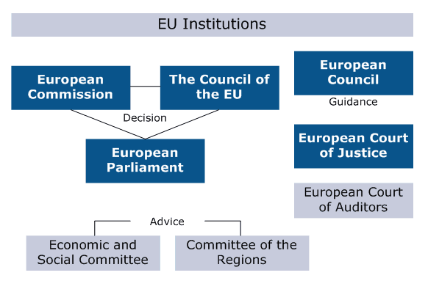

Slide 3
THE EUROPEAN PARLIAMENT
The European Parliament represents, according to the 1957 Treaty of Rome, “the people of the member states reunited in the European Union”.
The first direct elections for the European Parliament took place in June 1979. The number of terms is given to the states depending on their size.
The Parliament is the only communal institution that has public meetings and conferences. Its debates, notices and resolutions are published in the European Union’s Official Journal. The President’s Conference reunites both the Parliament’s President and the presidents of the various political groups, thus forming the political body of the Parliament. The President’s Conference coins the agenda of the general assemblies, marks the dates of the activities led by different political bodies and dictates the structure of the committees and delegations coming from the Parliament, while also imposing the number of members of each entity.
The Parliament has three fundamental roles, exemplified below:
Alongside the EU’s Council, it has a legislative role, by which we understand adopting the legislation of the EU (rules, directives, and decisions). Its involvement in the legislative process aids to guaranteeing the democratic legitimacy of the published texts.
It splits the authority in the budgetary area with the EU’s Council, thus being able to modify budgetary expenses. In an ultimatum, it adopts the budget as a whole.
It exercises democratic control over the Commission and has the right to censor it. The Parliament also exercises political control over the institutions’ ensemble.
The European Parliament’s headquarters are in Strasbourg, where one-week long meetings take place once per month. Some meetings take place in Brussels and the General Secretary can be found in Luxembourg.

Slide 4
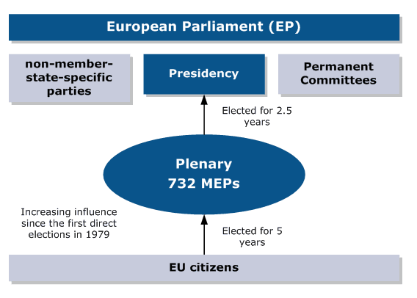

Slide 5
THE EUROPEAN UNION’S COUNCIL
As stated in the European Union Foundation Treaty, the European Union Council has the following responsibilities:
It represents the legislative authority of the community: in cases of larger issues that need to be dealt with, the Council exercises its power alongside the European Parliament.
It coordinates the general economic policy of member states.
It concludes, on behalf of the community, international treaties between the Union and other states or international organizations.
Together with the participation of the European Parliament, it forms the budgetary authority which later on adopts the Union’s Budget.
With regard to the treaty of the European Union:
It adopts the necessary decisions needed to define and apply common defense and security policies.
It coordinates the activity of member states and adopts the necessary measurements in terms of police and law cooperation. The Council is assisted by a general secretary, which prepares and ensures the well-functioning of its measurements on all levels.

Slide 6
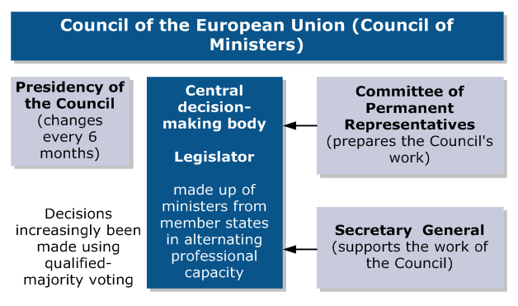

Slide 7
THE EUROPEAN COMMISSION
The Commission has three fundamental roles:
The right of initiative: its role as political initiator among European Union institutions is unique. Moreover, it acts as the executive body of the union, taking responsibility for the application of all the concluded treaties. The Commission represents the mass opinion, signifying the Union’s personality. Its main preoccupation is guarding the interests of European citizens. The members of the Commission are chosen from EU member states, each of them vows for their individual independence.
Guarding the treaties of the EU, so that the legislation is correctly applied upon all the citizens, and that all the citizens who are part of the single market can benefit from the ensured conditions.
It represents the executive body of the Union, taking responsibility into implying and coordinating various policies. One of its executive attributes is administrating the annual budget of the Union and of the structural funds that have as main purpose erasing the differences between the rich and poor zones of the EU.

Slide 8
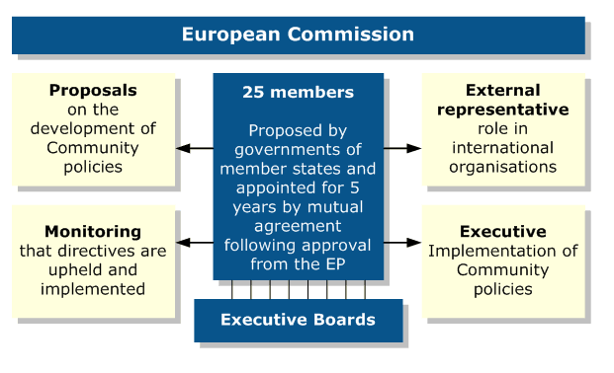
28 members

Slide 9
THE EUROPEAN COURT OF JUSTICE
Like any other viable law system, the Court’s system includes the existence of some jurisdictional insurance that function in case of contesting or applying communal legislation.
The European Court of Justice, as a jurisdictional institution of the community, represents the backbone of this insurance system. The judges must insure the homogeneity of the interpretation and application of the communal right in each member state, its maintenance as a communal system and its application, identical to everyone who vouches under this right.
When it comes to fulfilling its role, the European Court of Justice has the competence of providing solutions for litigations, that have as parts the member states, communal institutions, private businesses or people in general.
The European Court of Justice plays an essential role in the institutional system, defined through Treaties. The Court mostly maintains the balance between the prerogatives of the communal institutions, on one hand, and the prerogatives given to the community and the member states, on the other.
The general judges and lawyers are appointed by the member states’ governments for a 6 year long term, with the possibility of renewal. They are chosen from jury members who possess an incontestable political independence and professional competence.
The judges also choose the President of the Court for a 3 year long mandate, with the possibility to be renewed.
THE COURT OF FIRST INSTANCE
The Court was founded in 1989 with the purpose of solidifying law insurance given to the people by installing a second level of legislative authority, allowing the ECJ to focus on its fundamental purpose.
This Court, however, is not solely an institution, but rather a component of the ECJ. Regardless, it is an independent body, separated from the European Court of Justice in terms of organization. The Court of First Instance has its own clerk and its own procedure rules.

Slide 10


Slide 11
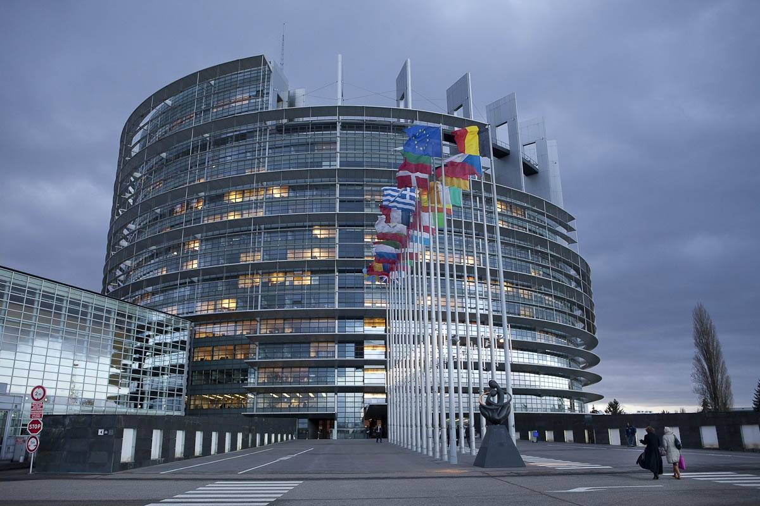

Slide 12
THE EUROPEAN COURT OF AUDITORS
The European Court of Auditors is the “youngest” institution of the European Union, founded after de Brussels Treaty (22nd of July, 1975). Its activity began in 1977. The headquarters can be found in Luxembourg ever since 1980. The European Court of Auditors’s main attribute is checking the accounts of the EU budget, with double purpose of bettering the administration of financial resources and informing the EU’s citizens about the use of public funds by administrative authorities.
The European Court of Auditors is formed of 28 members, one from every member state, appointed for a 6 year long term. The members are politically independent and are experienced in terms of public finances. The Court members choose their President for a 3 year long mandate.
The independence of the European Court of Auditors insures the objectivity of its activity. Named the “financial consciousness” of the EU, the Court does not have jurisdictional prerogatives. In case the members of the Court find out about injustices, including fraud, the communal competent bodies are immediately noticed so that mandatory punishments are applied.
The European Court of Auditors’ purpose is realizing an expertise of the European Union budget and checking the viability of each expense and redistribution made by the EU alongside its bodies, accurately emphasizing the EURO records, and contributes, through its activities, to strengthening the single market coin.
THE EUROPEAN INVESTMENT BANK
The European Investment Bank possesses a distinctive personality from the communal one, being administrated by its own bodies, according to its status, which forms the object of a protocol enclosed to the European Union Treaty, thus being able to act independently on financial markets as any other independent bank. In terms of administration, the European Investment Bank is strongly connected to the community through the objectives it promotes. According to the Maastricht Treaty and the EU Treaty, the creation of a new economic body was brought to discussion, thus becoming the European Investment Bank, one with judicial personality and the power to independent decisions and initiatives.

Slide 13
