Slide 1




Commitment for the
Active European Citizenship
ELICIT-PLUS – 2014-1-FR01-KA200-002362
This project has been funded with support from the European Commission. This communication reflects the views only of the author and the Commission cannot be held responsible for any use which can be made of the information contained therein.

Slide 2
Group opinion about the individual commitment as an active European Citizen

Slide 3

We want your feedback on this course.
Feedback is information about what was done and how in light of some goal. It reports what did and did not happen, without making any judgement.
The purpose of feedback is to provide information and observations about a performance.
https://bigideasineducation.ca

Slide 4
Please write on the posters, for this course:
Explicit
Implicit
Objectives
Hidden

Slide 5
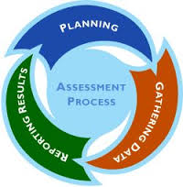
Assessment
(the process of documenting knowledge, skills, attitudes, and beliefs)
Several criteria
Relevance of information
Clarity of explanation
Accuracy of examples
Depth of ideas
Impact of activities
Sustainability of the attitudes
………..
www.pinterest.com

Slide 6
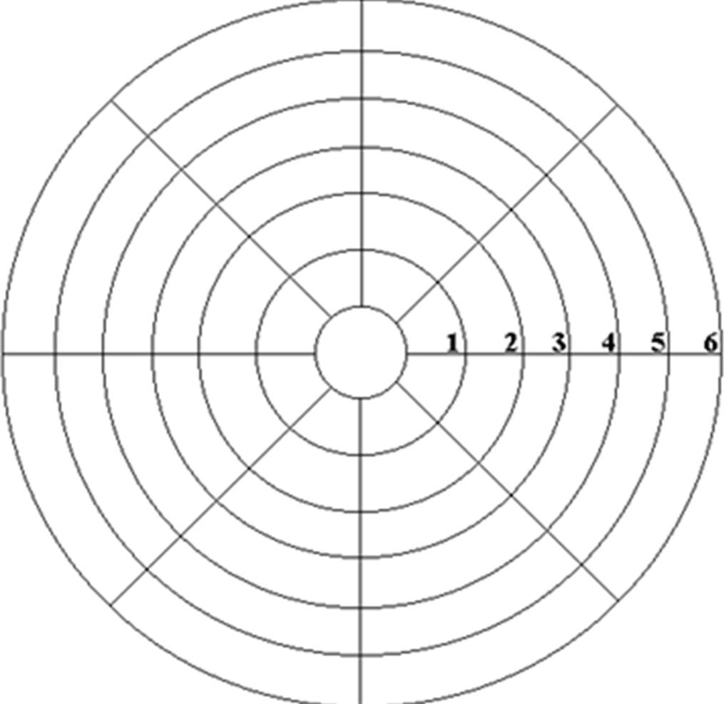
How much did you appreciate in this course?
Questions to be avoided
The daily schedule
The support materials
The whole organization
The ambience/atmosphere
The quality of the presentations
The contents and ideas
The training methods/tools
The colleagues implication
My own contribution
The proposed teamwork
The trainers’ performance
Others

Slide 7

Please argue on the posters your opinion about!
The offered information
The used methodology
The course effectiveness

Slide 8

Please fulfill succintly this form!
What did I truly learned?

Slide 9


Thanks for your attention !

