Slide 1



About evaluation
If you can’t measure it, you can’t improve it.
Lord Kelvin (1824 - 1907)
ELICIT-PLUS – 2014-1-FR01-KA200-002362
This project has been funded with support from the European Commission. This communication reflects the views only of the author and the Commission cannot be held responsible for any use which can be made of the information contained therein.

Slide 2
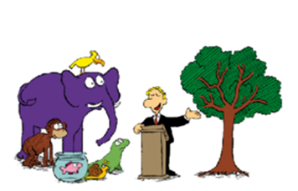
For a fair selection, everybody has to take
the same exam: please climb that tree.

Slide 3

……….
……..
……….
……….
……………..
…………….

Slide 4
Information
Regulation
Controle
Evaluation.
What for?
Appraisal
Certification
Improvement
Dyagnose
Counseling

Slide 5

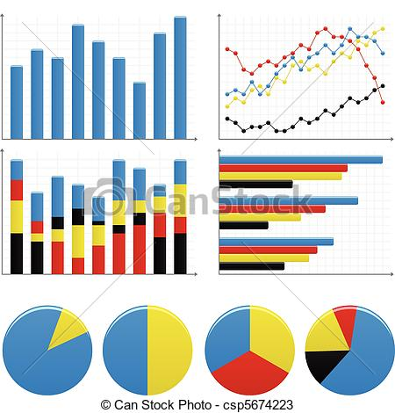
Assessment techniques

Slide 6
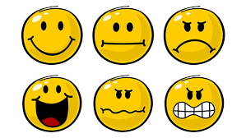
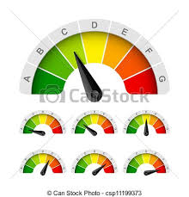
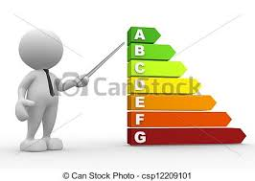
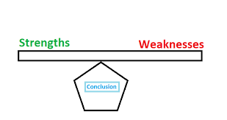
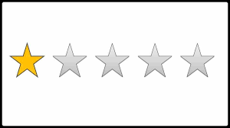




Evaluation symbols

Slide 7
What does evaluation mean?
Evaluation is the criterial collection of information regarding the worthiness, appropriateness, goodness, validity, etc., of something already measured or assessed.
Measuring
(determining attributes)
Assessing
(indicating performance)
Monitoring
(registering the progress)
Evaluation is the systematic exploration and judgement of working processes, experiences and outcomes, paying a special attention to aims, values, perceptions, needs and ressources.

Slide 8
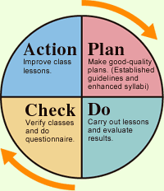
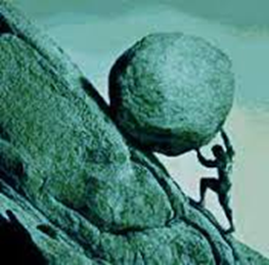
E. Deming’s cycle
Quality control
http://educationalevaluation1.blogspot.ro

Slide 9
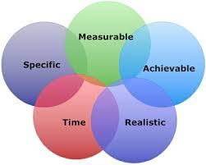
Training/learning objectives should be SMART

Slide 10
Active European Citizenship – Commitment
Cognitive
Information & Awareness
Psychomotor
Methods & Techniques
Affective
Attitudes & Behaviour
Training objectives

Slide 11
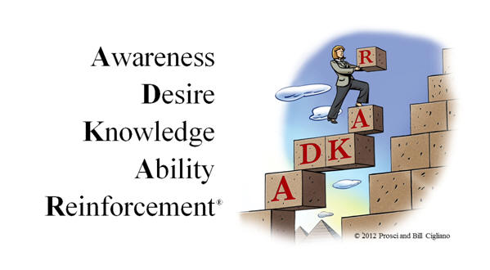
The Prosci ADKAR Model
Learning what to look for during change
https://www.prosci.com/about

Slide 12
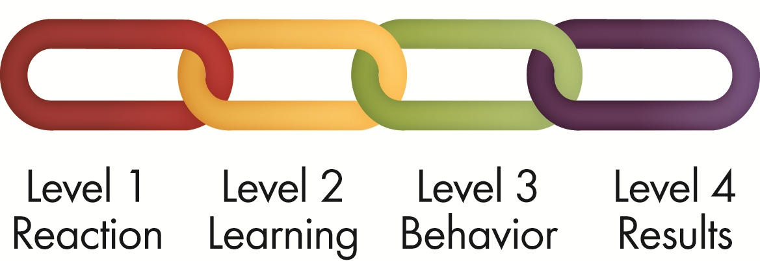
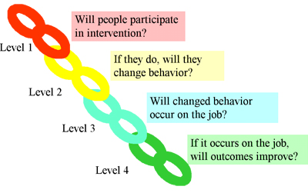
Kirkpatrick's Four-Level Training Evaluation Model

Slide 13
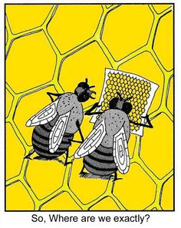
So, where are we exactly?

Slide 14
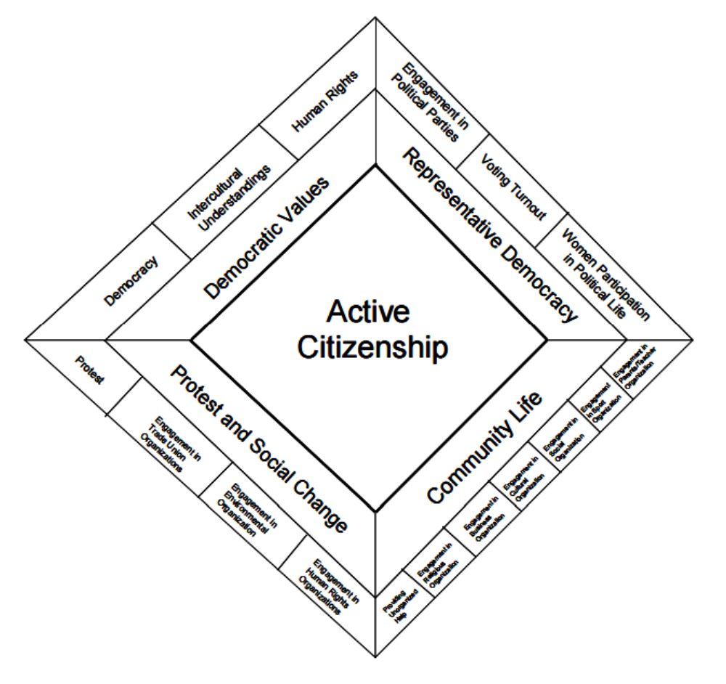
The structure of Active Citizenship (Hoskins and Mascherini, 2009)

Slide 15
Title of this ELICIT+ module:
Active European Citizenship – Commitment
Active citizen is that person who wants to make a positive difference to the local community or to an individual person, or make something good happen.
Please answer very honestly, by Yes/Perhaps/No,
the following questions, on the distributed paper sheets!
Thank you!

Slide 16
A. As an Active European Citizen would I …
… take part in consultations and questionnaires about EU issues?
… put pressure on the council or Government by taking part in direct actions concerning the European Union?
… assist or provide advice to a public institution dealing with human rights, democracy, tolerance?
… take part in decision-making that affect a community belonging to the European Union?
… write on Facebook/Twitter/… about the EU citizenship?

Slide 17
B. As an EU Voter, would I …
… be informed about EU issues by reading newspapers/listen to radio/ watching TV/surfing the web?
… be informed about the possible European representatives?
… vote for the European Parliament and choose the right people?
… make sure that I am on the register of electors?
… register for a postal vote if I have mobility issues?

Slide 18
C. As a Good European Neighbour, would I ….
… help foreign persons by giving information about local services?
… help foreign people to be less dependent on public services?
… keep a watch on our foreign neighbour’s home while they are away?
… shop at a local, family owned business, belonging to a foreign?
… start a reading club in the area, in order to inform foreign people about our national literature?

Slide 19
D. As an EU Responsible Citizen would I …
… protect the environment: start recycling my waste, clean up rubbish along a river, beach or park?
… donate unwanted clothing/toys/books/the old computer to a charity shop/ library/school?
… attend open evenings, support local charity events?
… answer questionnaires, respond to surveys, give feedback, attend neighbourhood meetings about EU?
… put notice boards at service providers about EU issues?

Slide 20
E. As an European Volunteer, would I …
… do some office work for a foreign organization?
… plant flowers/trees in public areas that could use some colour?
… volunteer at Red Cross helping foreigners?
… visit senior citizens at a nursing home?
… give blood ?

Slide 21
F. As a Community Activist would I …
… take action to change a local situation: campaign, write to parliamentarians/to the editor of the local newspaper?
… establish a network or group, set up or sign a petition, make lobby for an European/national decision?
… join an organization promoting democratic values?
… organise an event to raise awareness of a community problem?
… advise and help making decisions about local services?

Slide 22
G. As an EU teacher would I like to …
… include in my lessons discussions about EU institutions and decisions?
… explain to students and parents the meaning of the EU belongingness?
… create in school a centre of debates about European values?
… help my students to edit a school revue about the EU ?
… liaise with local institutions and to reinforce the sense of national and European citizenship?

Slide 23
H. What else would I do?
……….
…………
……………
……………..
…………………
……………………
……………………….

Slide 24
I. Which personal skills could your active behaviour as EU citizen develop or reinforce?
………………..
……………..
……………….
………………
……………….
………………..
………………..

Slide 25
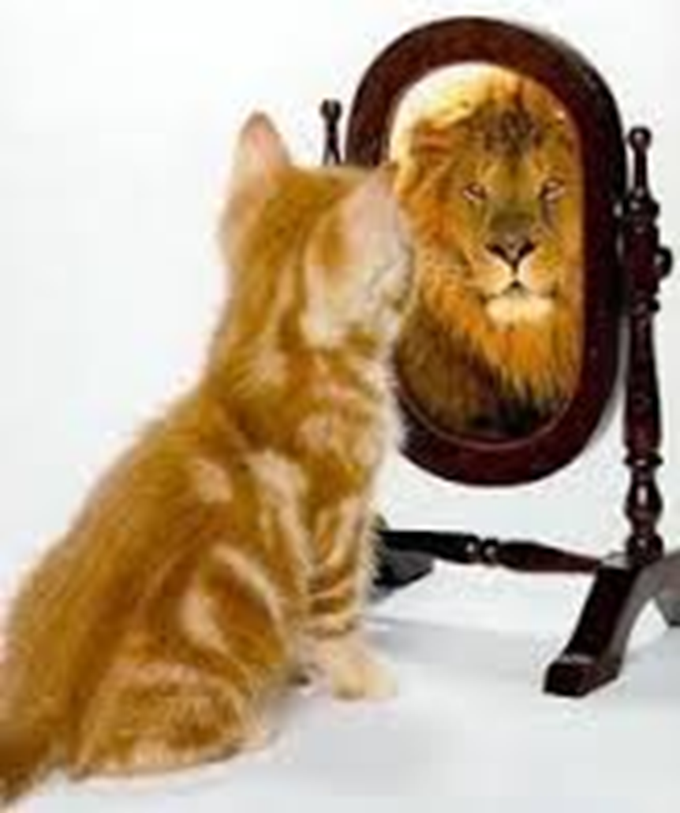
In writing a self evaluation
Be proud!
Be concise !
Be honest !
Be professional !
Be willing to go further !

Slide 26
My personal change
Which was my current state at the beginning of this training? Why?
What did I want to find out/learn? What did I found/learned?
What did I want to change? What did I change?
Which barriers avoided more changes in my personality? Did I overcome them?
What do I intend to do in a different way? Do I have chances to succeed? Why?
Draw your transformational trajectory during this training week.

Slide 27

Attitude makes altitude!
Zig Zagler

Slide 28
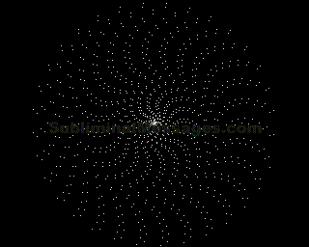
Thanks for your attention and interest!
Lucreţia Şirinian & Vasile Nicoară
Fundaţia Academică Alumni, Constanţa, Romania
Lucreţia Şirinian & Vasile Nicoară
Fundaţia Academică „Alumni”, Constanţa, Romania

