Slide 1


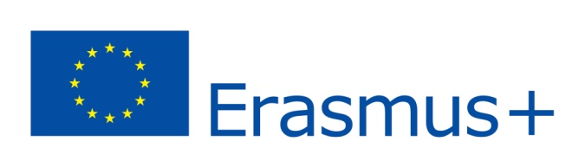

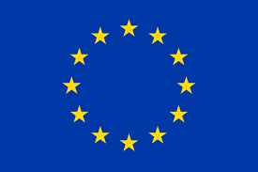
The History of the European Union Foundation

Slide 2
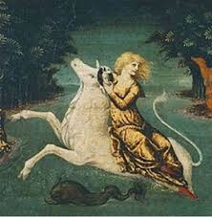
The etymology of this word is prehellenic Aegean (thus Indo-European): Europe originates from the word "hirib" (sunset, twilight), the antonym of "asu" (Asia) which means sunrise.
The legend: There was once in Tyr, Phoenicia (today’s Lebanon), a princess named Europe, daughter of king Agenor. One night she dreamt of two territories, which took the form of two women: "the land of Asia" and "the land of the front" quarreling about the princess. The former wanted to keep her, whereas the latter, inspired by Zeus, intended to send her far away. Intrigued, Europe woke up and walked by the sea shore to collect flowers. There, a handsome and tame bull appears and convinces her to hop on its back. Once climbed, the princess is embarked on a vessel, where Zeus reveals his true identity. Europe is taken on Crete island and weds Zeus, giving birth to plenty of children (of which the legendary king Minos is included).
Europa – painting of Veronesse

Slide 3
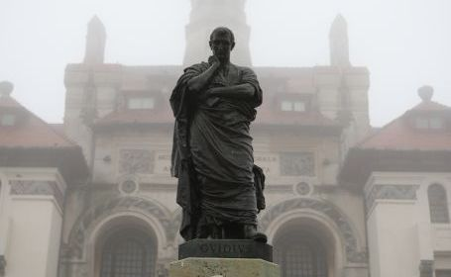
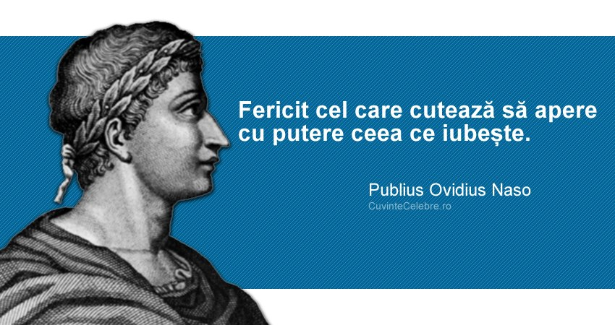
The statue of the poet Ovidius - Constanta - author : Ettore Ferrie, 1887
”Metamorphoses” by Ovidius - an epic poem, a mythological ”history” of the world’s genesis, of the metamorphosis of creatures and objects. Ovidius presents 250 legends which allegorize metamorphoses. Ovidius perceives the concept of metamorphosis as spiritual ”becoming” and evolution. The poet narrates legends referring to the transformation of gods into animals, such as the conversion of Lupiterin into a bull in order to kidnap princess Europe.
The Latin poet Publius Ovidius Naso, born in Sulmona (Italy) in 43 B.C., was exiled by Augustus in 8 A.D. in the Tomis (Constanta) citadel, where he writes the poems ”Tristia” and ”Pontica”. He also dies there in 17 A.D.

Slide 4
The European identity
In 800, at the enthrone of Charlemagne, the poets of the court considered him as the new sovereign of Europe. Europe is then seen as a synonim of "the new Rome". The Carolingian Empire is the very first European unification.
The second European unification was "Republica Christiana" (with a somewhat comparable meaning "Christendom") in the 12th-14th centuries
The Catholic religion (in Greek "Katholikos" = universal) was enforced as a universal aim (common belief/creed). Except for the cultural diversity and the executory divisions, it promoted spiritual harmony. This new form of integrity can be seen in three types of unity:
- the unity of creed and of the ecclesiastic/clerical institutions (from liturgy to the religious calendar);
- the unity of social grouping and the interdependence of the three social classes: those who pray (the clergymen), those who fight (the knights) and those who work (the peasantry);
- the unity of writing and learning the Latin language, used as much in Church as in education and profane, blasphemous culture (literature, arts, arhitecture).

Slide 5
The third European unification - in the culture of the 16th-18th centuries, the Renaissance and Illuminism are the apogeum of this evolution. The elites exploit a globalised culture where hunting, dancing, theater and opera were similar interests. A typical example is Erasmus, born in Rotterdam; he studied in England and France, lived in England, Belgium, Switzerland, and Anglia, he was a speaker of 7 languages. After the invention of the printing machine (the printed version of the Bible by Gutenberg at Mainz, in 1455), the circulation of books and ideas is intensified.
Conclusion: the European Union political projects tested before 1945 are characterised through the following three fundation myths:
• the Universal Empire myth – from Carol the Great to Napoleon I, from the Holy Roman Empire to the Habsburg attempt of unification;
• the Pacifying Unification myth on the idea that unity eliminates all conflicts: Sully,
Kant, Saint-Simon, Aristide Briand (League of Nations), Jean Monnet;
• the Community of Values and Culture myth: "The Christiana Republic", The Republic of Letters (Enlightment).

Slide 6
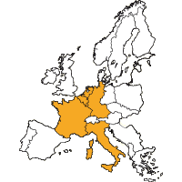
9th of May 1950
Robert Schuman, the French minister of foreign affairs, presents an in-depth cooperation plan. The 9th of May will later be proclaimed Europe Day .
18th of April 1951
Based on the Schuman Plan, six countries sign a treaty on which they establish to have a joint heavy industry managment (the coal and steel industry). Thus, none of the countries can manufacture weapons on its own that can be used against one another, like in the past.
The founder member countries: Germany, France, Italy, the Netherlands, Belgium and Luxembourg.

Slide 7
25th of March 1957
Starting from the success of the Treaty establishing the European Community of Coal and Steel, the six countries extend cooperation to other economic sectors. Thus, they sign the Treaty of Rome, through which they lay the foundation of the European Economic Community (EEC), also known as the “common market”. The purpose is to insure free movement of people, goods and service beyond national fronteers.
1973: Denmark, Ireland and the United Kingdom;
1981: Greece;
1986: Spain and Portugal;
1995: Austria, Finland and Sweden;
2004: Cyprus, Estonia, Latvia, Lithuania, Malta, Poland, Czech Republic, Slovakia, Slovenia and Hungary;
2007: Bulgaria and Romania;
2013: Croatia
1st of November 1993
The Treaty concearning the European Union is enforced and the European Comunities (CECO, EURATOM and CEE), along with the External Policy and the Common Security Policy ; Justice and Internal Affairs represent the three pilors of the EU.

Slide 8
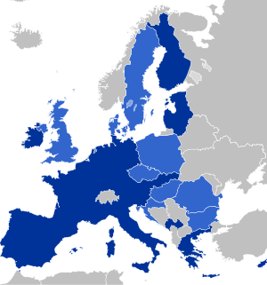
1st of January 1999
The release of the unique European currency ”EURO” in 11 European state which accomplished the convergence criteria. At present, there are 19 states in the European Union.
The map of the states which had introduced the euro currency – 2017

Slide 9
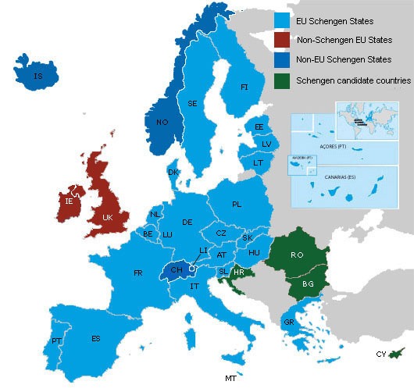
14th of June 1985
The agreement of free circulation was signed in the little Luxembourgish town Schengen and the creation of Schengen space started on 26th of March 1995 with Belgium, France, Germany, Luxembourg, the Netherlands, Portugal and Spain and, at present, there are 25 states (including Switzerland, Lichtenstein, Iceland, Norway, besides Great Britain, Ireland, Bulgaria, Cyprus, Croatia and Romania) whose total surface is 4,312,099 square km.
The map of Schengen space, 2017

