Slide 1




EDUCATIONAL SYSTEM IN ROMANIA

Slide 2
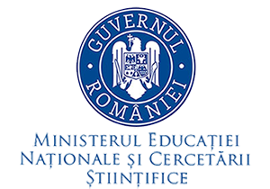
The education system is managed at the national level by the Ministry of National Education and Scientific Research.
(Romanian: Ministerul Educației Naţionale și Cercetării Științifice, MENCŞ)

Slide 3

THE STRUCTURE OF THE EDUCATION SYSTEM
ANTE-PRESCHOOL EDUCATION
(0-3 years)

Slide 4

PRE-PRIMARY
(EARLY)
EDUCATION
organised for children aged 3-6 in three age-groups:
low (3-4 years)
middle (4-5 years)
high (5-6 years)
Pre-primary education is not compulsory.

Slide 5

PRIMARY EDUCATION (compulsory) – organised for pupils aged 6-10 and including the preparatory grade and grades I to IV

Slide 6
LOWER SECONDARY EDUCATION - organised in two successive cycles (both compulsory):
Gymnasium – Gimnaziu – grades V to VIII for pupils aged 10-14
Lyceum – Liceu - lower cycle - grades IX and X for pupils aged 14-16

Slide 7
UPPER SECONDARY EDUCATION, organised in:
Lyceum – Liceu - upper cycle (non-compulsory) – grades XI to XII/XIII for pupils aged 16-18(19), with the following paths: theoretical vocational (a duration of 3 years) and technological

Slide 8
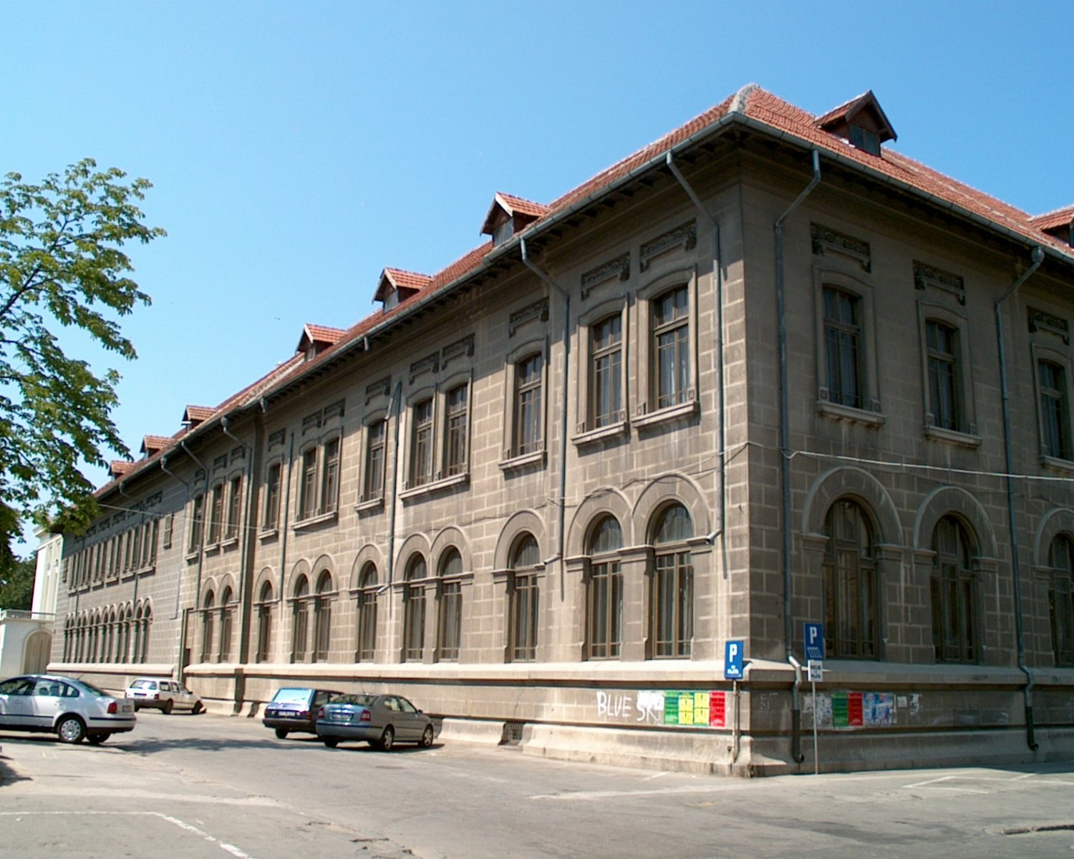


Colegiul Naţional "Mircea cel Bătrân"
Str. Ştefan Cel Mare nr.6 Cod Poştal: 900726, CONSTANŢA, ROMÂNIA
RO
Telefon : +40341-405801 Fax: +40341-405800
E-mail: cnmbct@gmail.com website: www.cnmbct.ro

Slide 9

POST-SECONDARY NON-TERTIARY EDUCATION, including post-high schools

Slide 10

TERTIARY
EDUCATION, including university and post-university education

Slide 11
The delivery of degrees is through many different institutions but the structure of provision is based on the Bologna principles. As such there are three cycles of study:
first cycle of 180 to 240 ECTS] (three to four years) leads to a bachelor’s degree (Diploma de licenta)
a second cycle of 60 to 120 ECTS (one to two years) leads to a diploma of advanced study (Diploma de Studii Aprofundante) or the or a master’s degree (Diploma de master)
a third cycle of 120 to 240 ECTS leads to a PhD degree (Diploma de Doctor)
European Credit Transfer and Accumulation System (ECTS)

Slide 12
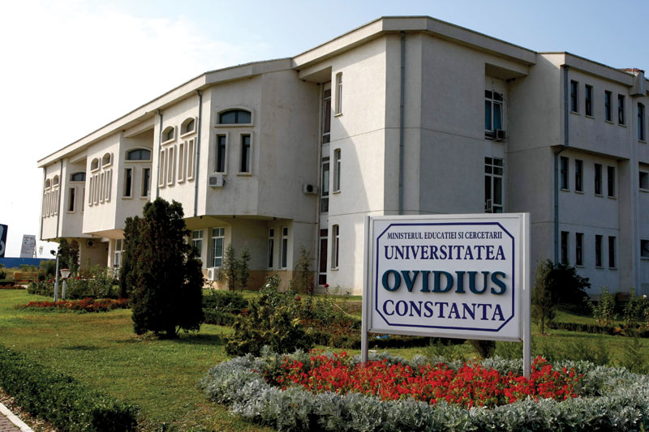

Slide 13

According to the provisions of the Law of National Education (Law 1/2011), public education is free of charge, based on an egalitarian system in compliance with the law. Access to free education is guaranteed by Article 32 in the Constitution of Romania.

