Slide 1



Education & Entrepreneurship
Vidáné Moroz Szimóna
Székesfehérvári SZC Széchenyi István Műszaki Szakközépiskolája
Székesfehérvár
AEDE-HU

Slide 2
Secondary education
Students can choose from the following secondary school programmes:
Vocational school programmes, special vocational school programmes
Secondary general school programmes
Secondary vocational school programmes

Slide 3
Vocational schools
Students who do not intend to obtain a secondary school leaving certificate and wish to begin working immediately after the compulsory period of education, have the opportunity to attend a vocational school.

Slide 4
Secondary general schools
The secondary general schools prepare for universities and colleges, provide high level foreign language teaching and a thorough general education. After the last year, students take school-leaving examinations.
standard-level exam
high-level exam

Slide 5
Secondary vocational schools
Secondary vocational schools offer the opportunity to learn a profession and provide general education as well.

Slide 6
Higher education
The secondary school leaving examination also functions as an entrance exam (at standard and advanced level).
In the academic year 2006/2007, the structure of the Hungarian higher education system started to replace the dual education form accepted in the European Union.

Slide 7
Dual Education System
Dual Education System is called “dual” because it combines apprentices in a company and vocational education at a vocational school in one course. In the company, the apprentice receives practical training which is supplemented by theoretical instruction in the vocational school.
Education or training combining periods in an educational or training centre and in a workplace.

Slide 8
Vocational Education and Training
For the past 25 years, vocational education and training in Hungary has undergone significant changes.
Vocational Education and Training events took up speed in the past five-six years and resulted in a modern, dual VET system. It is based on the German model and has been established in accordance with Hungarian demands.

Slide 9
Dual training is a central pillar of European VET systems
The goal is to strengthen work-based learning and cooperation between education and the world of business.
It is necessary to promote high quality practical training based on apprenticeship contracts.
The expected skills on the labour market can be ensured effectively by the improvement of learning outcomes and the standard of education.

Slide 10
What are the characteristics of the system in countries operating dual vocational education and training systems?
Vocational education and training functions as a service, the aim of which is to fulfil the labour market needs of a successful economy, and to provide career opportunities for a young, skilled workforce.
The aim of training skilled workers is not the acquisition of lexical knowledge, but to train successful and efficient employees.

Slide 11
What are the characteristics of the system in countries operating dual vocational education and training systems?
As for enterprises the main motivating force is not short-time profitmaking, but high level training of the future employee, which is considered an investment with a long-term return.
As the vocation is being learnt in the course of work, the chances of an employee to find a job increase significantly, while the employer can minimize the costs of training and wrong employment.
Training in the school workshop prepares for practice at the firm, however everybody has to take part in external practice in a life-like situation.

Slide 12
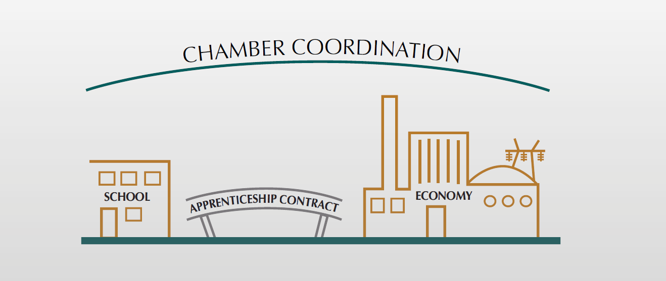

Slide 13
Forms of practical training in dual vocational training in Hungary
In Hungary, practical training can be pursued in the school workshop, or at the enterprise or other organization entitled to pursue practical training.
Therefore the student can participate in practical training in the following forms:
• based on an apprenticeship contract, or
• based on an agreement for cooperation, or
• in the training workshop of the school.

Slide 14
Students in dual vocational education and training
The apprenticeship contract provides the following advantages for the
student:
they can gain practical experience in life-like working circumstances,
they can learn the use of tools, devices, technologies applied at the organization, learn to socialize in a workplace environment, get familiar with the requirements they have to meet

Slide 15
Students in dual vocational education and training
after finishing their studies, their job prospects are better,
they receive regular monthly remuneration,
they get into the social security system, have insurance, are entitled to receive sick leave benefit and the period of apprenticeship is counted into the service time when pension is calculated.

Slide 16
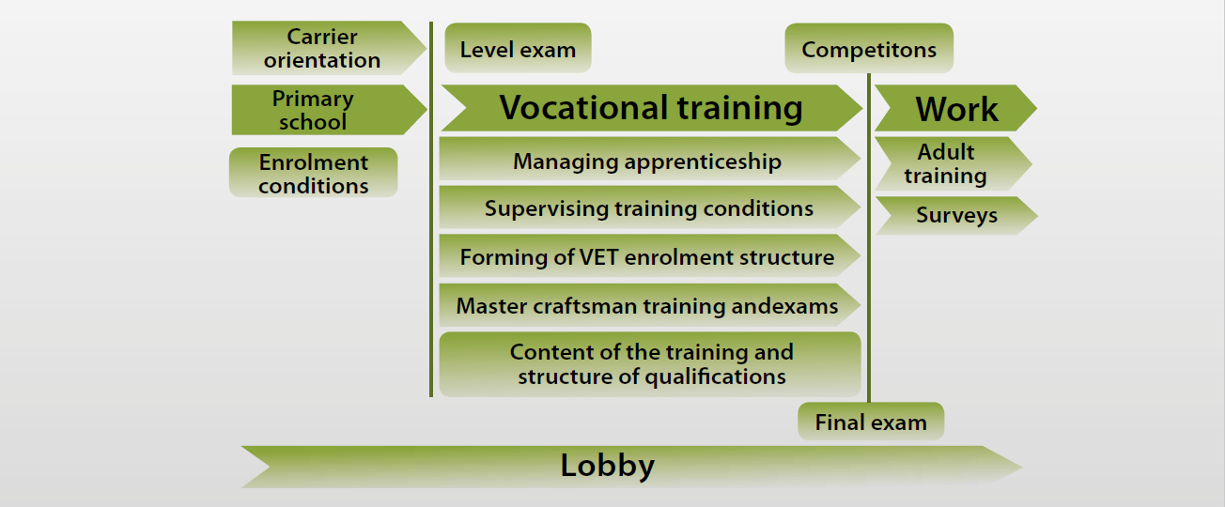
What are the responsibilities of the Chamber? – Operating the Hungarian dual vocational training system

Slide 17
Modernising Higher Education
In December 2014, the Hungarian government adopted a higher education strategy. As a way to improve the labour market relevance of tertiary education, dual programmes were introduced in five study fields — technical, informatics, economic sciences and natural sciences, agriculture.
The Dual Training Council, which is composed of government, university, chamber and company representatives, was set up in 2015 to coordinate dual programmes, engage and prepare companies and ensure quality assurance of the work-based learning component.

Slide 18
Higher education strategy 2015-2030
The strategy sets the agenda for development of the Hungarian higher education system over the next 15 years, aiming to achieve a 35% tertiary attainment rate
The objectives of the strategy are:
establish a performance-based higher education system and improve its quality;
boost the research element of higher education and research careers;
strengthen links between local/regional businesses and higher education.

Slide 19
Modernising vocational education and training and promoting adult learning
Vocational schools and vocational upper secondary schools will be managed by the Ministry of
National Economy instead.
The current vocational school types are being renamed without changes in the curricula. In the new system, szakgimnázium leads to a professional upper secondary school-leaving qualification (4+1 year), while the three-year szakközépiskola, in which pupils could enrol as of September 2012, offers a vocational qualification.
While structural barriers have been removed, the increasingly strict admission criteria for higher education give little chance for students from this school type to enter into higher education.

Slide 20
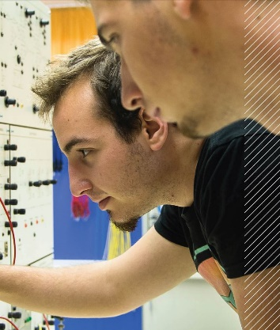
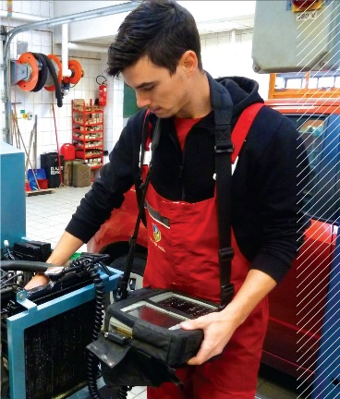
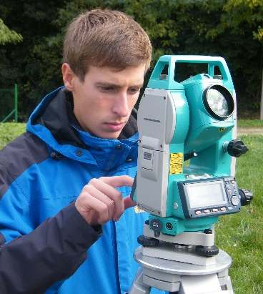
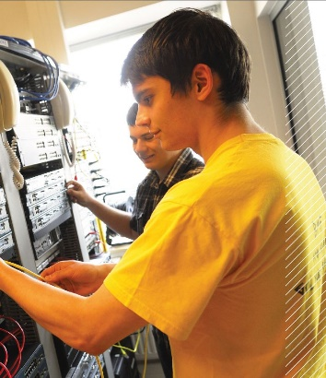
The interns’ academic year in dual practice
Őszi félév szorgalmi időszak (14 hét) / Study period semester of Autumn
(14 weeks)
A nappali tagozatos hagyományos hallgatókkal együtt / Together with the full-time students
Gyakorlati időszak 8 hét / Practical period 8 weeks
Tavaszi félév szorgalmi időszak
14 hét / Study period semester of Spring
(14 weeks)
A nappali tagozatos hagyományos hallgatókkal együtt / Together with the full-time students
Gyakorlati időszak 16 hét / Practical period
16 weeks
Vizsgák / Exams
1 hét szabadság / 1 week leave
3 hét szabadság / 3 week leave
Vizsgák / Exams

Slide 21
Outcome: graduate with practical experience
AZONNAL BEVETHETŐ MÉRNÖK / Immediate deployment of ENGINEER
KORSZERŰ IPARI, TECHNIKAI ÉS HELYI ISMERET / MODERN INDUSTRIAL, TECHNICAL AND LOCAL KNOWLEDGE
MAGAS SZINTŰ ELMÉLETI KÉPZÉS / HIGH-LEVEL theoretical training
specifikus gyakorlati képzés a vállalkozásnál / specific practical training at the enterprise
hallgató bevonása konkrét „üzemi” gyakorlati feladatokba / involving student of specific "operational" practical exercises
projekt jellegű munka az önálló munkavégzés képességének megteremtése érdekében / project-based assessment for the capacity to work independently
„puha” készségek és munkakultúra megtanítása / Teaching of "Soft" skills and work culture

Slide 22







































Places of internships
50 enterprises!!!

Slide 23
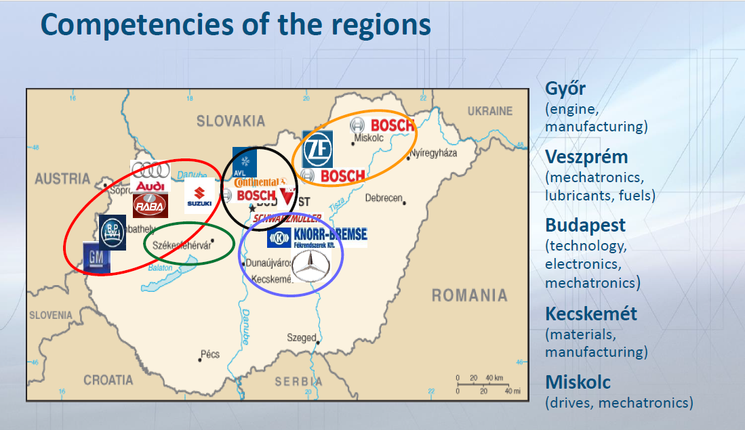

Slide 24
Missions
Mass vs quality education
• Practical training
• Real problem-solving
• Work practice at graduation
• Building connections with the company

Slide 25
Advantages
Students
More knowledge
Employee
Company
Professional recruitment
Training-time reduction
University
Connections

Slide 26
Thank you for your attention!
Vidáné Moroz Szimóna
AEDE-HU

